Slide 1

Second Sprint Iteration
Team: Codeachrome
Members: Donald Dedman, Jeremiah Doody, Timothy Folds, Julio Orozco and John Verdi

Slide 2

World Arts Film Festival

Slide 3
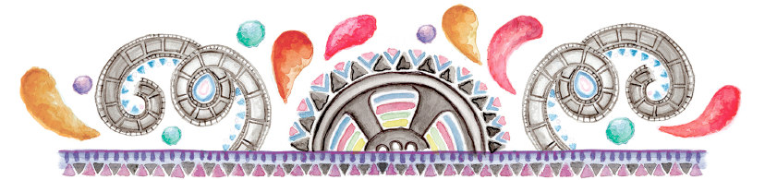
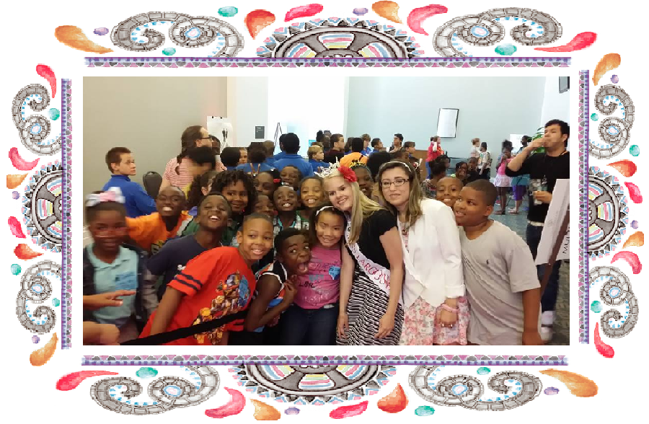
Community partner overview
Director of World Art Films Festival (WAFF)
Looking for help in creating a voting system
Currently has no system set up
Recently held WAFF event
Notes:
By, Timothy Folds
Image from: http://worldartsfilmfestival.org/wp-content/uploads/2014/06/10378980_750658528287944_7701419404167767015_n.jpg
I added the boarders to it

Slide 4

Project overview
E-voting and feedback system (EVFS)
Consists of 3 main parts
Voting
Mobile voting
Administration
Adding/Modifying/Deleting information
Viewing reports
Demographics, Leader boards, Voting data (winners)
Notes:
By, Timothy Folds
Image from: http://www.projectinsight.net/articles/articlesshare/i/2013/project-puzzle-pieces.jpg

Slide 5
Functionalities
Some functionalities requested by community partner:
Collect minimal data on first interaction with system
Get voter emails to send newsletter
Request anonymous demographics: education, age, household income and ethnicity
Collect votes from voters
Do so quickly
Admin control
Add, modify, delete Film, Artist, Event and Block entities.
Demographics (minimal data mining)
Mobile option for users
Notes:
By, Jeremiah Doody and John Verdi

Slide 6
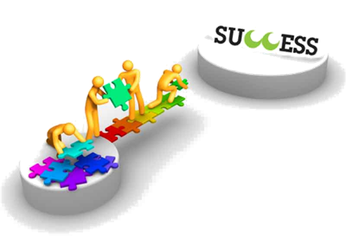
Work Completed
Expanded and refined
User stories
Project vision
Software development plan
Database ERD
Attended WAFF event
Outline use case specification
Complete use case specification
Deliverable 2
Notes:
By, Timothy Folds
Image from: http://www.successwithcrm.com/Portals/76666/images/successwithcrm-teamwork-resized-600.jpg

Slide 7

Work Completed
Set up Repository on Github
Created MVC project in WAFF solution
Created classes based on ERD
Created database project in WAFF solution
Created tables based on ERD
Created second iteration documentation and product release
Notes:
By, Timothy Folds and John Verdi
Image from: http://www.ipmglobal.net/img/ipm-guys-gears.jpg

Slide 8
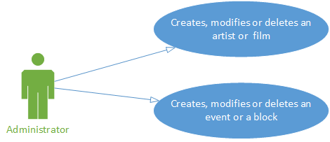
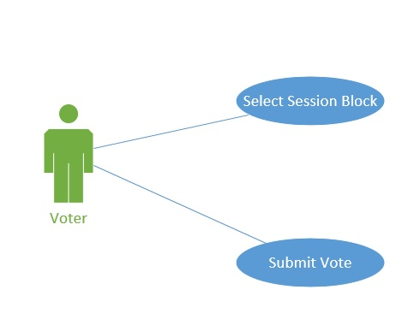
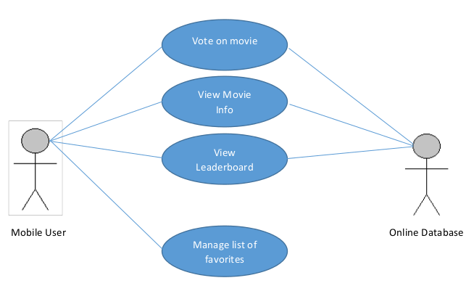
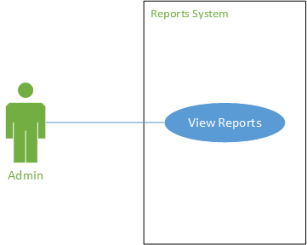
Use-case overview and models (diagram)
Notes:
John Verdi

Slide 9
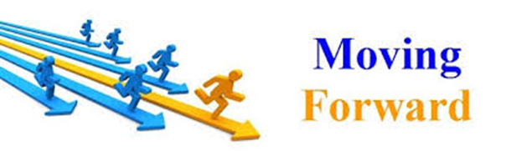
Third sprint iteration
Activity Diagrams
Object Oriented Analysis (UML)
Analysis Models
Interaction Diagrams
Minimal Viable Product
Notes:
By, Timothy Folds
Image from: https://encrypted-tbn0.gstatic.com/images?q=tbn:ANd9GcShUbNe-32UjO8sXGmGhjuxDdaHyXTE8wOZRL73956cwu7hUNsW

Slide 10
Problems Faced
Major Issues
Learning Curve (Visual Studio)
Issues with Github (version control)
Entire meeting trying to fix Github nodes
Database Design change over sprint
Communication and vision clarification between stakeholders
Minor Issues
Fixing Use-Cases to be as accurate as possible
Ensuring that all documents use the same terminology
Tying Use-Cases to user stories
Notes:
By, Jeremiah Doody and John Verdi

Slide 11
Lessons Learned
First hand experience at Film Festival
Using Git (Gitbash, Github)
Our mentor introduced us to using Git
On learning to push and pull, the nodes were knocked out of whack.
Improved methodology to ensure project integrity
How to Create a database using MSQL
Creation of Use-Cases
Learned how to express functionality in document without being too specific.
Notes:
By, Jeremiah Doody and John Verdi

